Slide 1
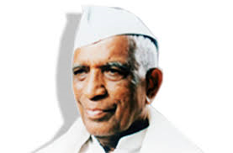
COUNCIL of Education’s Deshbhakta Ratnappa Kumbhar College of Commerce, Kolhapur
Department of Law & Department of BBA
In collaboration with
Aptech Aviation Academy
organizes
A Guest Lecture On
Career Opportunities in Banking, Finance & Aviation Sector
Speaker – Mr. Gaurav A. Munj
President – Prin. Dr. V.A. Patil
Coordinator
Prof. A.S. Jadhav & Prof. S.S. Benade

